Slide 1

Project on
DISASTER MANAGEMENT
DEPARTMENT OF COMPUTER SCIENCE AND ENGINEERING
CSE 2112 : OBJECT-ORIENTED PROGRAMMING LAB
University of Dhaka
Presented by
Group -02
SUMAIYA RAHMAN SOMA (07)
CHOWDHURY SHAFAHID RAHMAN(55)

Slide 2

Introduction
The disaster management system is a project designed to address the needs of citizens, administrators, and responders during emergency situations.
Its primary focus is to ensure smooth communication, disaster reporting, and help coordination.

Slide 3
Objective
Allow users to report disasters, receive survival guidance, and access emergency contacts.
Enable admins to manage disaster reports, assign tasks.
Provide volunteers with the ability to track their performance and report task completion.
Facilitate smooth communication and coordination between clients and admin by chat application.

Slide 4

TOOLS
IDE: IntelliJ
Language: JAVA
Framework: JavaFx
Database: MySQL
Testing: Manual testing for the overall system functionality

Slide 5
CONTRIBUTION
Sumaiya Rahman Soma
Chowdhury Shafahid Rahman
-SignUp & Login , Homepage
-Client Dashboard, Reporting (Client) , Survival Kit, Important Contact
-CSS Styling & adding colorful UI to the pages.
- Admin Dashboard, Assign Task, ,
Admin landing page
-Chat Application & code combining.
-Volunteer Dashboard, Volunteer Performance, Volunteer Assign Task

Slide 6
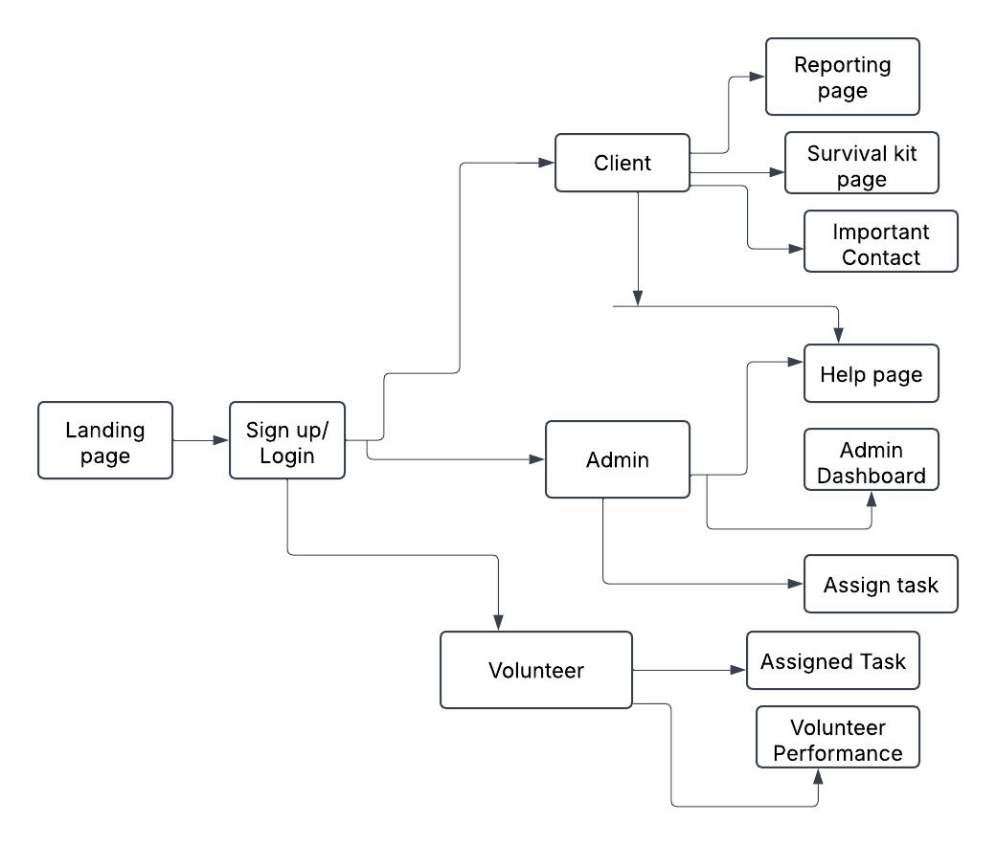
WORK OVERFLOW

Slide 7
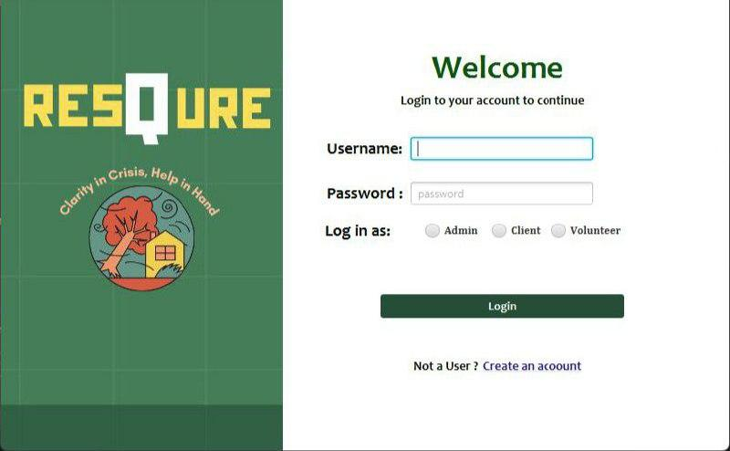
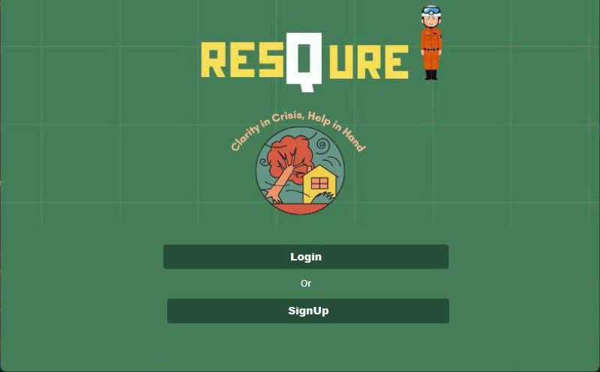
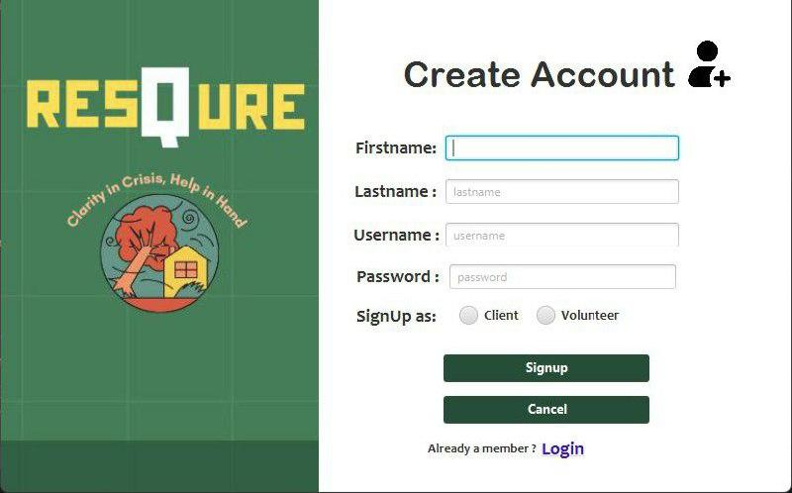
User Interface
Login page
Sign up & Login
-User will signup and login according to their role.
SignUp page
-This feature ensures authentication of the users by database connection and exception handling.
Landing page

Slide 8
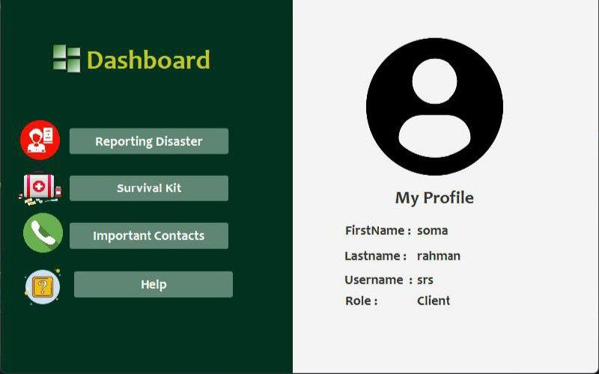
User Interface
Client Dashboard
-The Client’s basic information is displayed.
-The dashboard serves as the central platform for clients by providing access to key features .
Client Dashboard

Slide 9
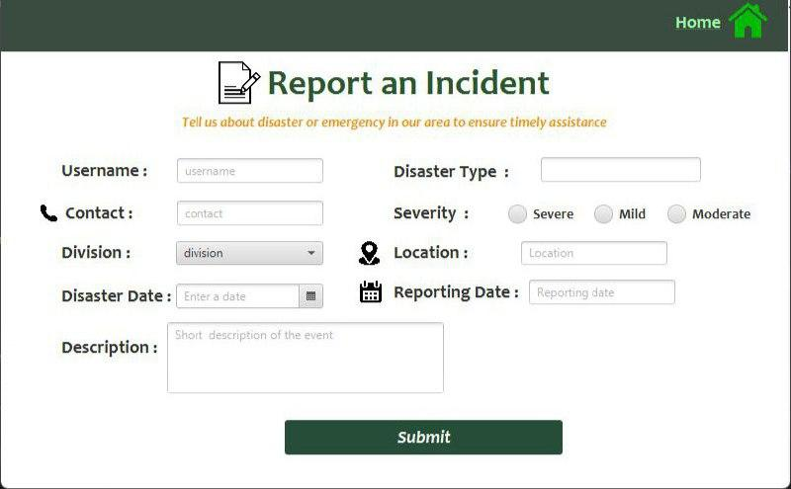
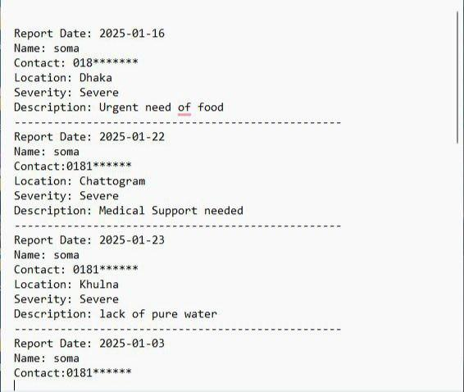
User Interface
Reporting Page
-Users can submit disaster reports with location, severity, and description.
-The information is stored in Admin’s database for further help.
-Using file writer method , a text based log file has been created.
Reporting page
Report log Information File

Slide 10
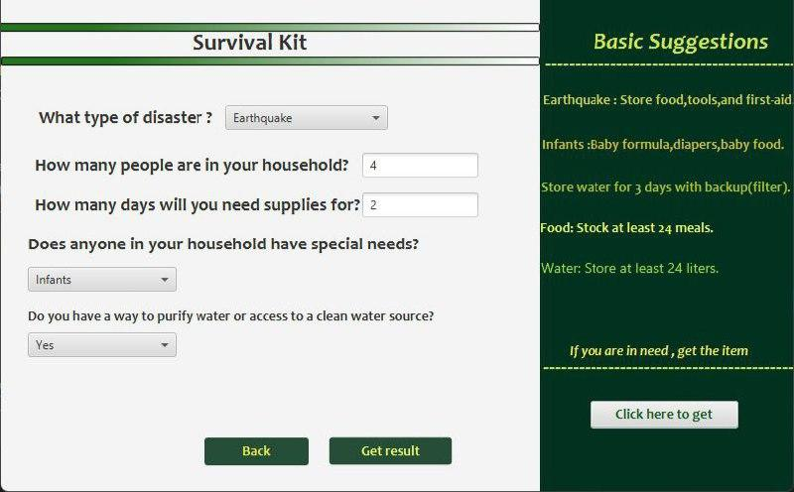
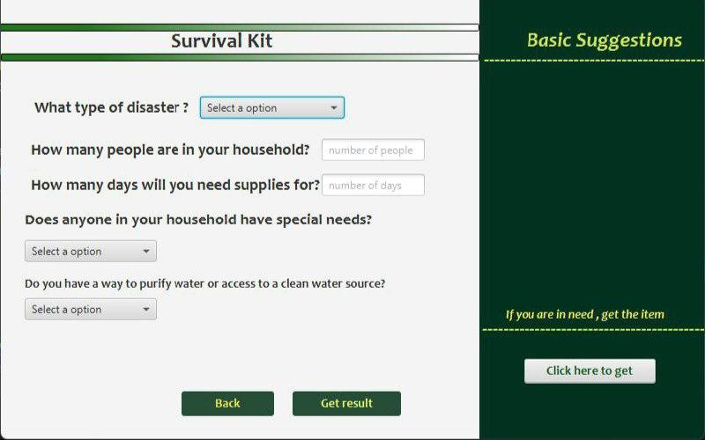
User Interface
Survival Kit :
-Offers specific advice based on the disaster type, special needs, and water availability.
-Helps users calculate the amount of food and water required for a certain number of days and people
- If the user in need, they can ask the items to admin.
Survival Kit page

Slide 11
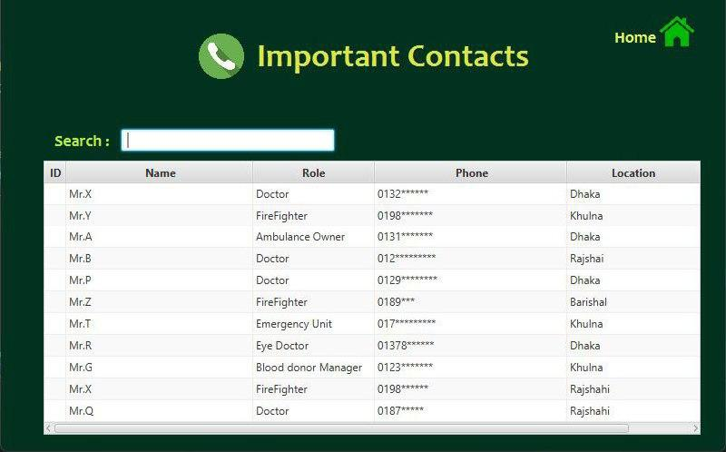
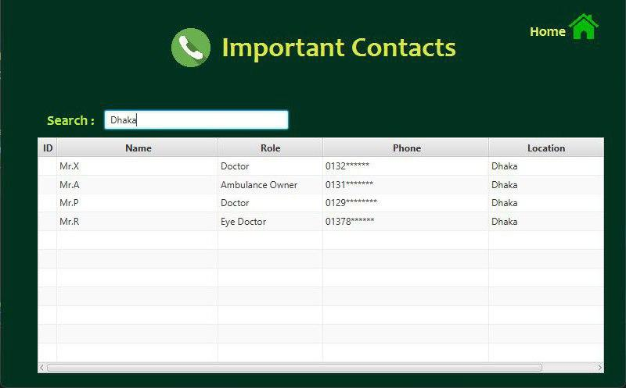
User Interface
Important contact page :
-Provides important contacts of different designation along with location.
-The data can be filtered out by designation or location for faster outcome.
Important Contact page

Slide 12
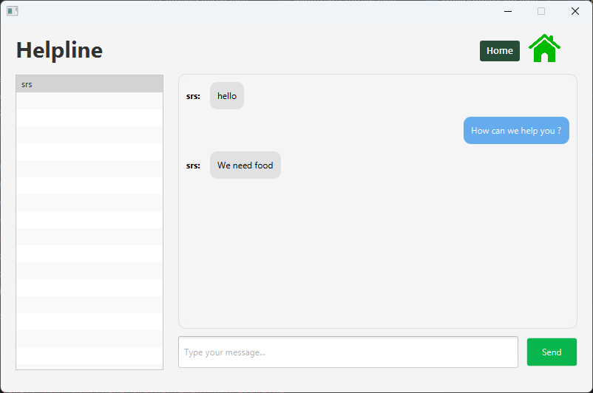
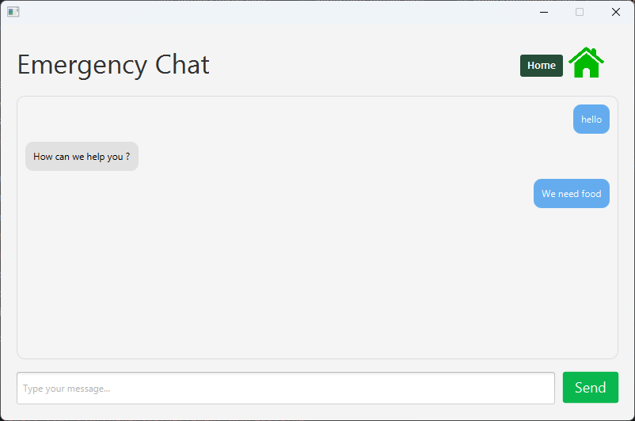
User Interface
Chat Application :
-The chat application enables real-time communication between client and Admin ensuring quick response during emergency .
-We used server-socket to build this.
Admin Helpline page
Client Helpline page

Slide 13
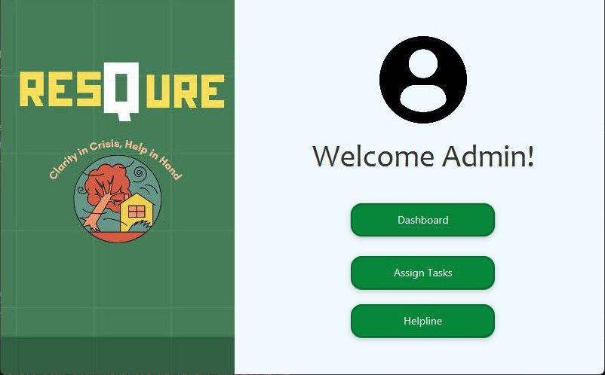
User Interface
Admin landing page :
-The landing page serves as the central platform for admins by providing access to key features
Admin Landing Page

Slide 14
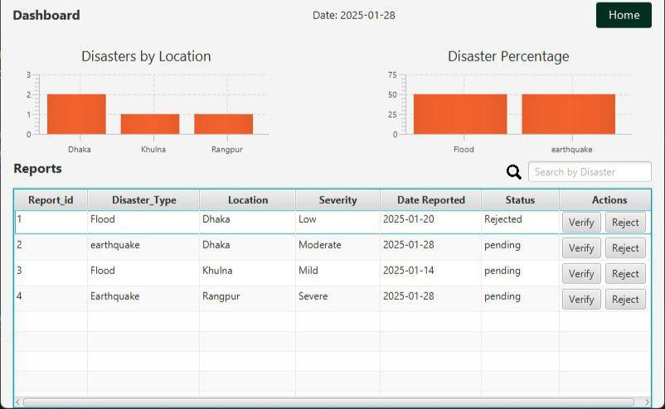
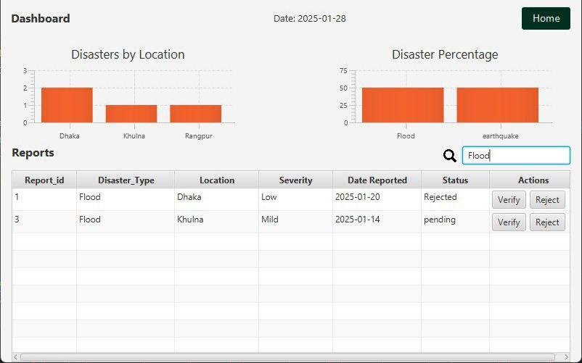
User Interface
Admin Dashboard:
-The dashboard provides all the reports submitted by the user.
-The bar graph highlights predictions of people who are most in need.
-The admin can verify and reject any report.
Admin Dashboard

Slide 15
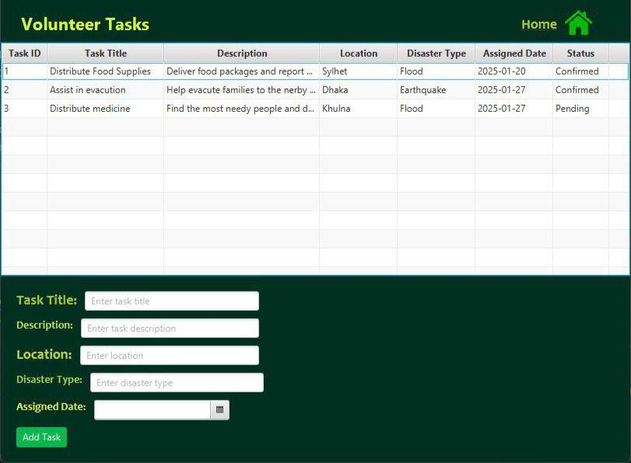
User Interface
Assign Tasks:
-Based on the clients need , admin can assign task to volunteers providing necessary information about the task.
Assign task page

Slide 16
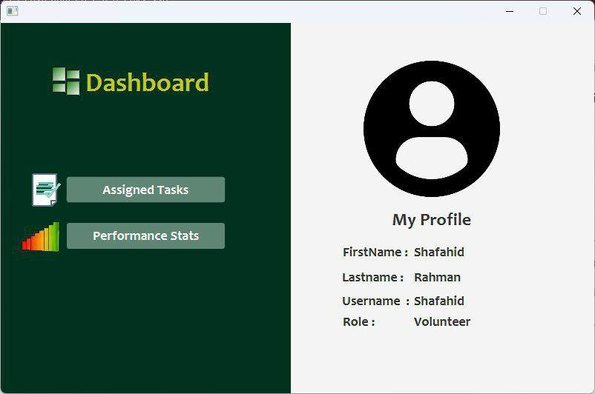
User Interface
Volunteer Dashboard:
-The Volunteer’s basic information is displayed.
-The dashboard serves as the central platform for volunteers by providing access to key features .
Volunteer Dashboard page

Slide 17
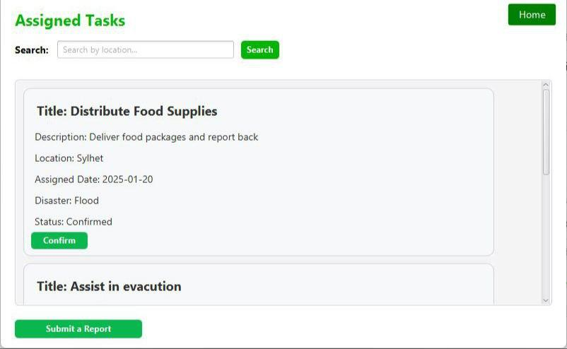
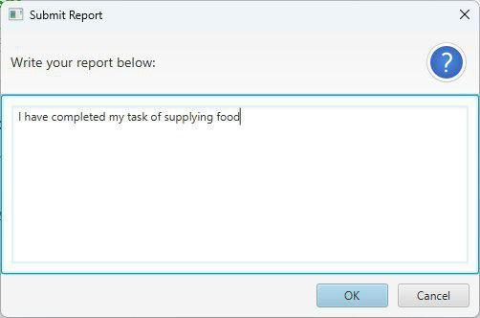
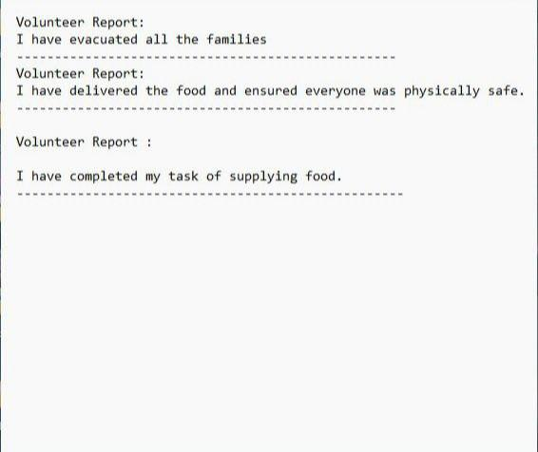
User Interface
Volunteer Assigned Task :
2
Volunteer can submit report after completing task
1
The tasks that have been assigned by admin displays here
3
In the text file, the report can be viewed.

Slide 18
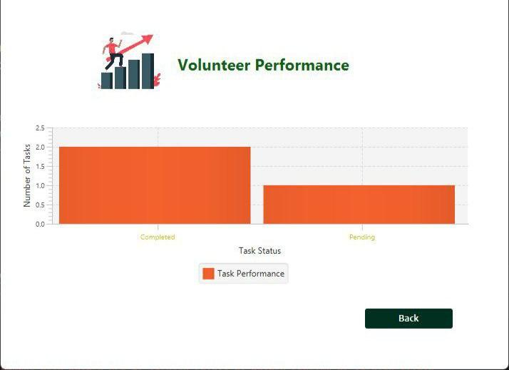
User Interface
Volunteer Performance:
-This section demonstrates the number of pending and completed tasks performed by volunteer using a bar graph
Volunteer Performance page

Slide 19
IMPLEMENTATION OF OOP PRINCIPLE
-Encapsulation : Hides internal data and provides controlled access through methods.
-Abstraction : Complex implementations by exposing only essential details.
-Polymorphism : One interface to work with different data types or behaviors .
-Inheritance : Reuse the code by allowing classes to inherit functionality from others .

Slide 20
FUTURE ENHANCEMENTS
-Potential Improvements :
-Improving efficiency and user experience.
-Automated notification alert.
-Data visualization feature & map feature.

Slide 21
Thank you

